Slide 1

Full Stack Project

Slide 2
Teer Brand – Official Website
(Revenue Generation)
Developed by
Shreshth Tarwey
(CodeSpice)
12307911
INT219, INT220

Slide 3



TEER BRAND
About
TEER BRAND
Established in 1992, Koderma, Jharkhand
Quality Spices and Products
Focus areas include:
Spices
Salts
Aims to provide un-beatable taste and flavour.

Slide 4
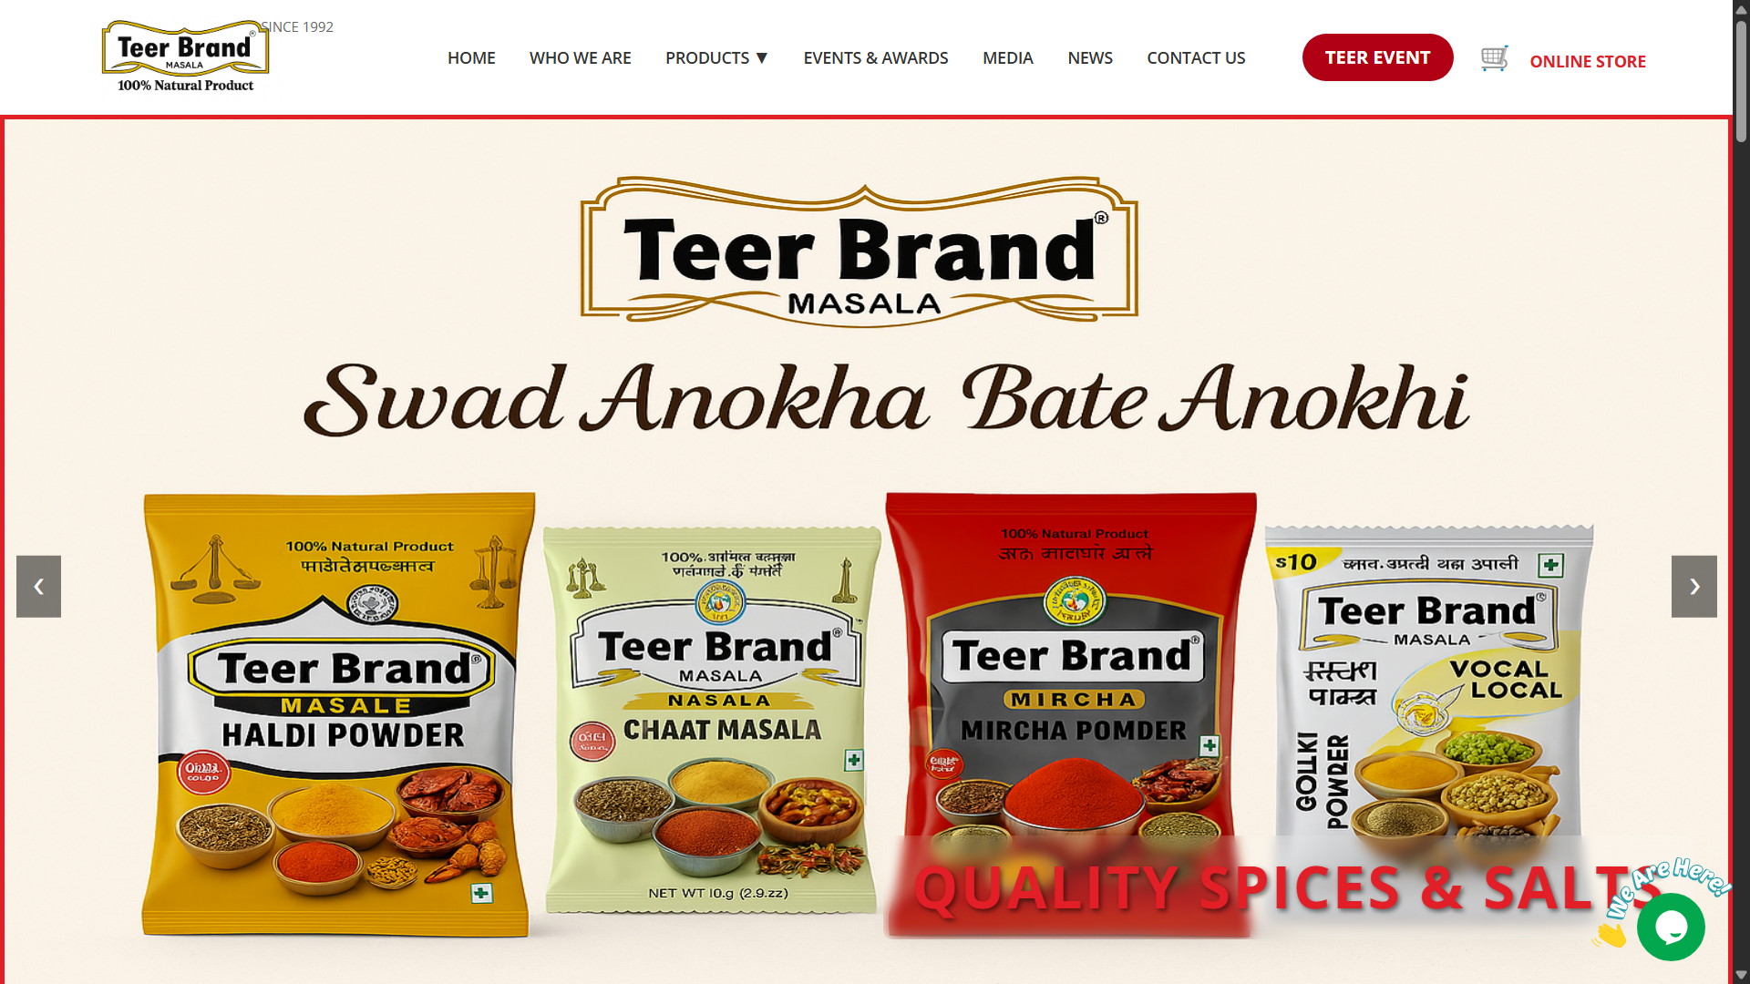
Landing Page of TEER BRAND

Slide 5
Project Description
Website Name: Teer Brand
Type: E-commerce Website for Spices
Purpose:
Showcase and sell high-quality spices produced by Teer Brand.
Promote traditional Indian spices through a modern digital platform.
Key Features:
User Authentication: Secure registration and login system
Product Display: Categorized spice listings with detailed info
Cart System: Add, view, and update items in the cart
Order Management: Place orders and view order history
Admin Panel: Update order status and manage orders
Goal:
Enhance customer reach beyond local markets
Establish Teer Brand as a global spice brand

Slide 6
Client Requirements
Professional Design:
The website must have a clean and professional appearance, avoiding flashy or overly decorative elements.
Simple Typography:
The client requested no funky fonts to maintain readability and professionalism.
Theme Alignment:
The design should reflect the essence of Indian spices, with colors and visuals that complement the spicy and traditional theme.
Ease of Use:
The website should be simple to navigate for all users, including those from rural backgrounds.
Mobile-Friendly:
Must be responsive and functional across devices, especially for mobile users.
Brand Focus:
Emphasis on Teer Brand’s identity and quality assurance of the products.

Slide 7
Tech Stack Used
HTML5:
Used for the basic structure and layout of all webpages.
CSS3:
Responsible for styling elements, maintaining a clean and professional look that suits the brand theme.
JavaScript:
Handled client-side interactivity, such as dynamic updates and form validations.
AJAX:
Enabled asynchronous operations like updating order status without page reloads, improving user experience.
PHP:
Managed server-side functionality including data processing, session management, and database interactions.
MySQL (via phpMyAdmin):
Used as the backend database to store and retrieve user data, product info, orders, and cart details.

Slide 8

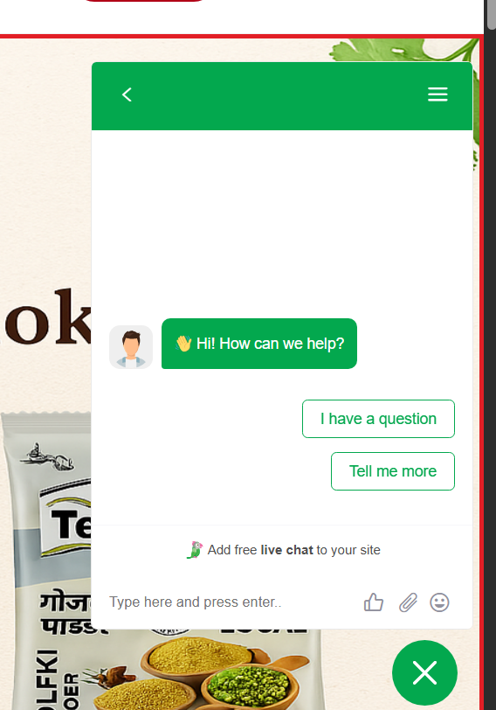
Real-Time AI Customer Support & Live Analytics
AI-Powered Customer Support:
Integrated concept of an AI chatbot to handle real-time customer queries, improving user engagement and response time.
Capable of providing product recommendations, order support, and FAQs handling.
Live Customer View Analytics:
Tracks active users, page visits, and browsing behavior in real-time.
Helps in understanding customer interest and optimizing marketing strategies accordingly.
Instant Doubt Resolution System:
Enables customers to ask live questions while browsing products.
Queries can be answered by either the AI assistant or manual backend support, ensuring immediate resolution.
Highly Applicable for Modern E-Commerce:
This feature ensures 24x7 assistance, boosts conversion rates, and creates a smart, responsive shopping experience.

Slide 9
Limitations of the Website
Solo Effort: Unlike other students working in groups of 3–4, this project was completed entirely by me.
Limited Full Stack Knowledge: I am still in the learning phase of full stack development, so advanced technologies like React.js and Node.js were not used.
Cart System Not Hosted Online: Due to PHP and MySQL backend setup, the cart system works only on localhost and is not available on live hosting.
Only Front-End Hosted: The frontend part of the website is hosted and available online, while server-side functionalities remain local.
Time & Resource Constraints: Managing all aspects—from design to coding—on my own limited the time for adding more dynamic or modern features.

Slide 10
Future Plan for Website
Website Upgrades: The website will undergo continuous improvements, including the addition of new features and enhancements.
Upcoming Features: We plan to introduce sections for News and Events, keeping users updated with the latest offerings and activities.
Fully Functional Cart & Database: A fully working cart system will be integrated along with a robust database for real-time inventory and order management.
UI/UX Improvements: Once client confirmation is received, significant UI/UX enhancements will be made to provide a more seamless and visually appealing experience.

Slide 11
Live Link of Website
https://teer-brand.vercel.app/

Slide 12
Live Link of Website
https://teer-brand.vercel.app/

Slide 13
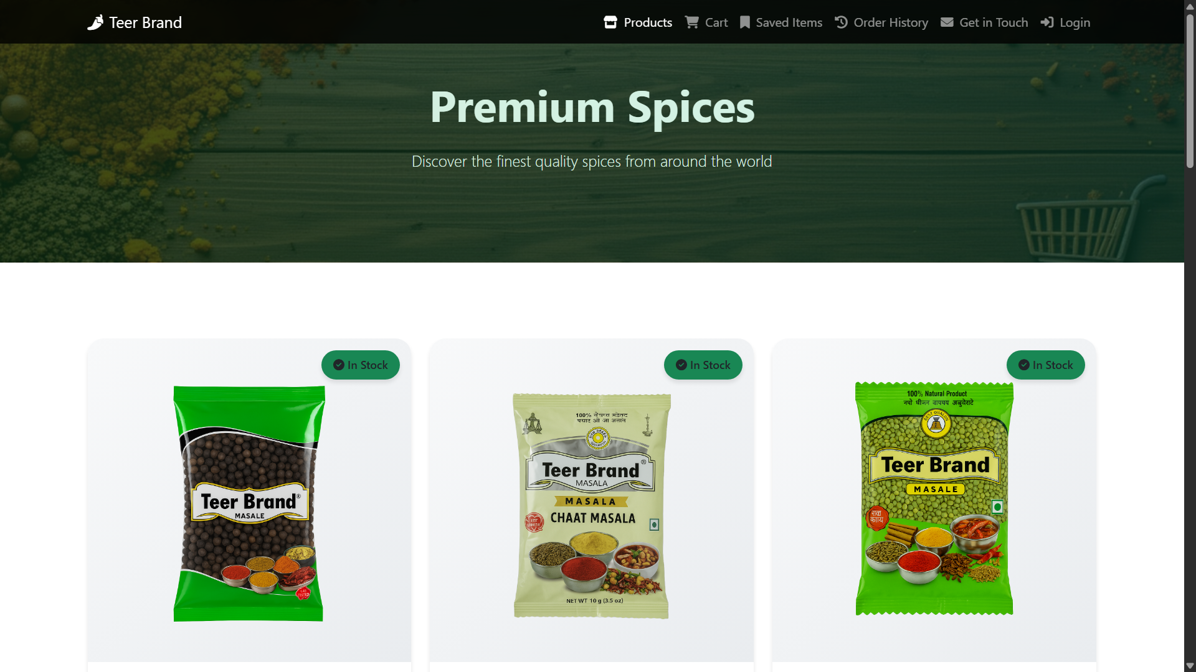
BACKEND PART

Slide 14
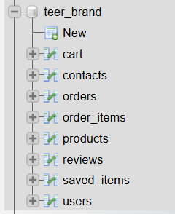
DATABASE DESIGN
The project uses a MySQL database named teer_brand to manage all backend operations.
The database is structured to support e-commerce functionality efficiently.
Tables included:
users – Stores user information (name, email, password, etc.).
products – Contains all product details like name, price, description, and image.
cart – Temporarily stores products added by users for checkout.
orders – Records confirmed orders placed by users.
order_items – Lists individual items within each order.
contacts – Saves messages submitted through the contact form.
reviews – Stores user-submitted product reviews and ratings.
saved_items – Lets users save favorite products for later viewing.
This relational design ensures data integrity, scalability, and efficient queries.

Slide 15
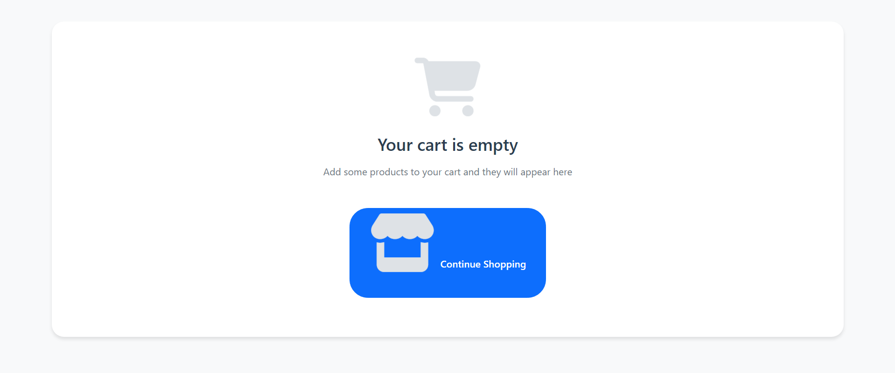
SHOPPING CART

Slide 16
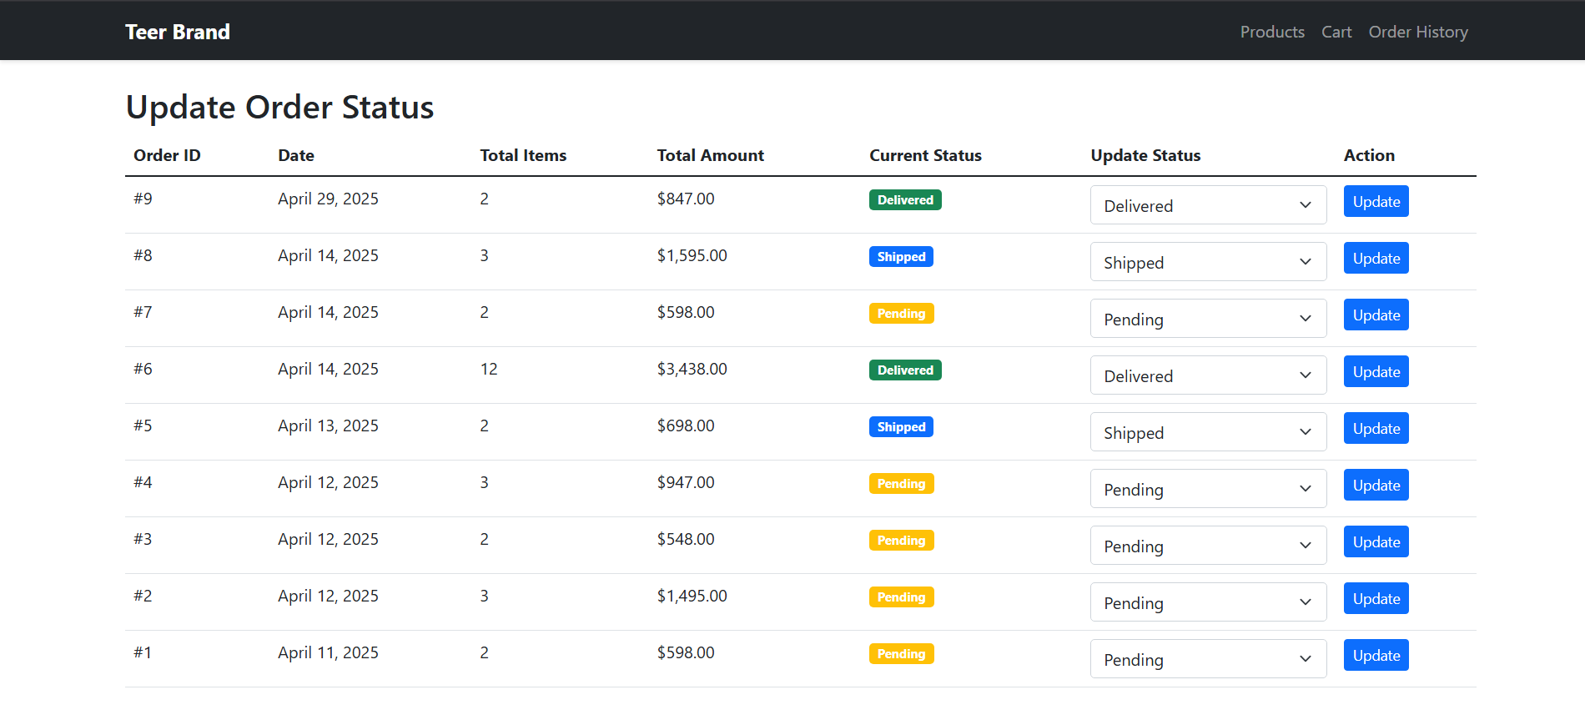
ADMIN PANNEL

Slide 17
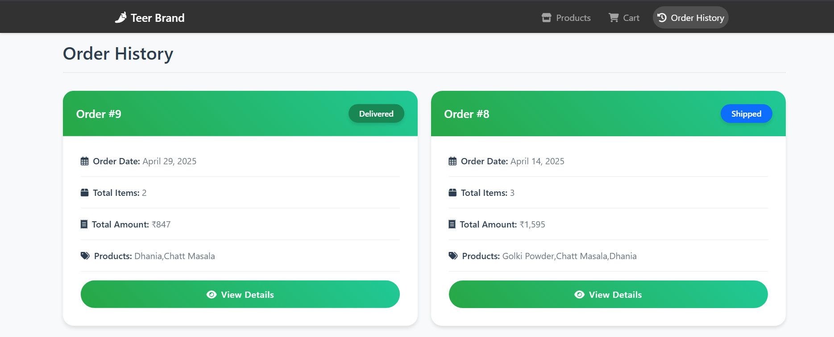
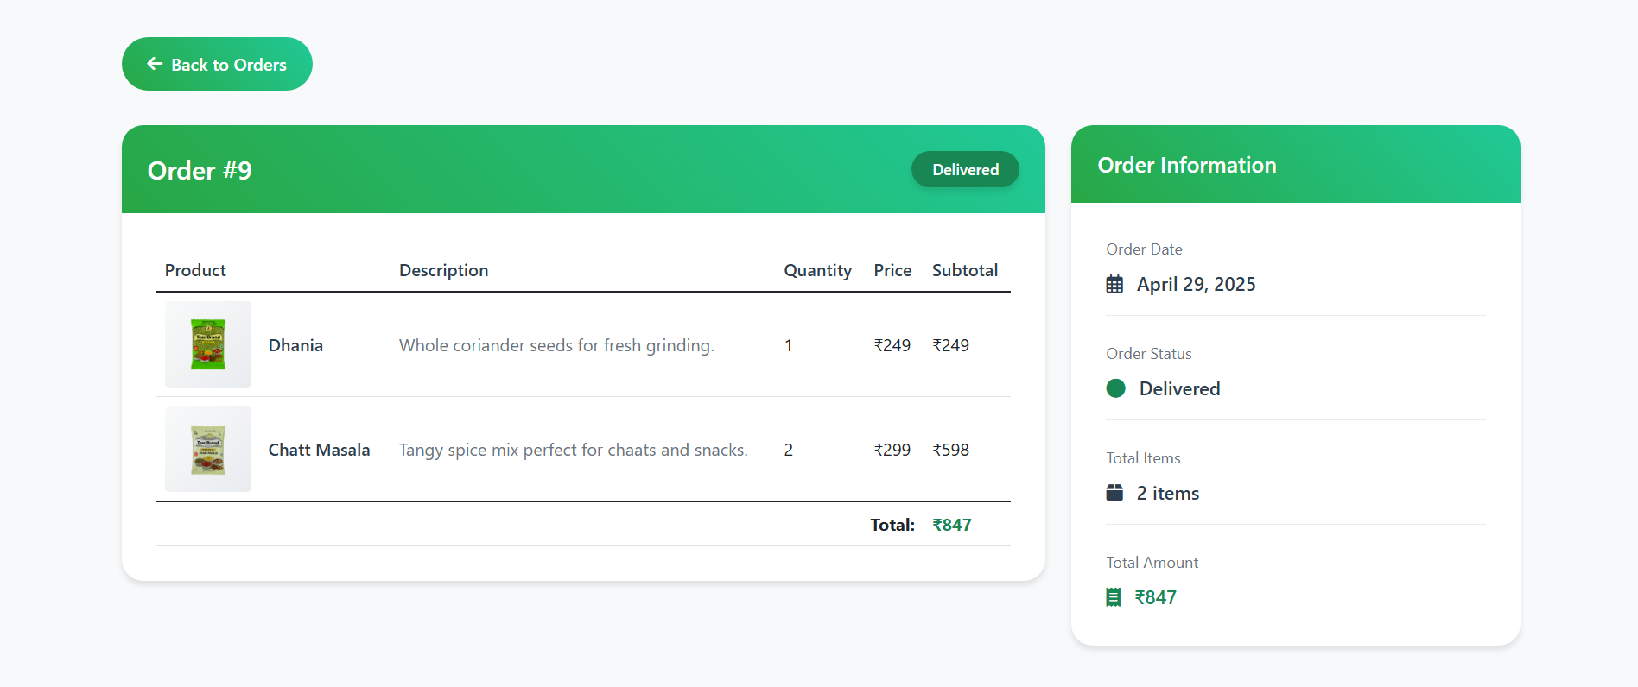
ORDER HISTORY FUNCTION

Slide 18


Slide 19
Now, let's take a closer look at the website and explore its features!

